Slide 1
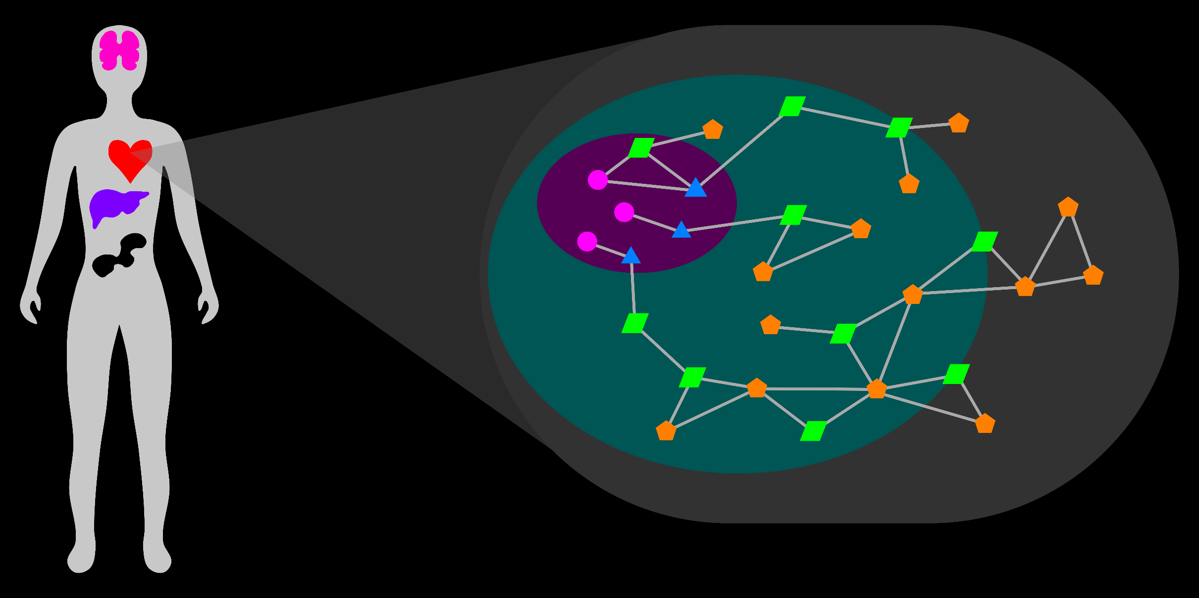
Visual Exploration and Analysis of the Metabolic Network
Rutter Team Meeting
15 December 2016
T Cameron Waller

Slide 2
Relevance, Goal
Biology
Biotechnology
Pharmacology
Medicine
Notes:
Metabolism sustains life.
Metabolism is an integral part of the biological system.
Defects in metabolism drive many human diseases.
The goal of this project is to develop computational methods to support the study of metabolism in domains of biology, biotechnology, pharmacology, and medicine.

Slide 3
Study of Metabolism
Design Experiments
Functions of individual entities
Processes
2) Interpret Results
Genomics
Transcriptomics
Proteomics
Metabolomics
Consider holistic context
Notes:
Slide 3
The study of metabolism
1) Design experiments to study functions of individual entities or processes.
2) Interpret results, especially from 'omics technologies (genomics, transcriptomics, proteomics, metabolomics).
In both of these cases, it is important to consider the holistic context of the metabolic system.

Slide 4
Current Technology
Databases
KEGG
MetaCyc
UniProt
Models
Recon 2.2
Explorers
MetScape
KEGG Atlas
Escher
Notes:
Describe current technology very briefly.

Slide 5
Challenges
Holistic context versus specific detail
2) Flexible, dynamic representations
3) Visualization of experimental results
Notes:
Slide 5
1) Preserve holistic context while providing specific detail.
Metabolism functions as a cooperative whole.
Need to consider and study metabolism holistically.
Metabolism is also vast and complex.
Need to consider relevant portions of metabolism in detail according to interest.
2) Represent selections of the network flexibly and dynamically.
Connection and cooperation between members of the metabolic system traverse and transcend typical pathways.
Interest sets of metabolism are custom and case-specific with great variety.
Need for automatic, dynamic representations that are clear.
3) Associate experimental results (data) with context of metabolic system.

Slide 6
Design Ideas
These are sketches to demonstrate ideas…
Notes:
The following images are sketches to demonstrate ideas.

Slide 7
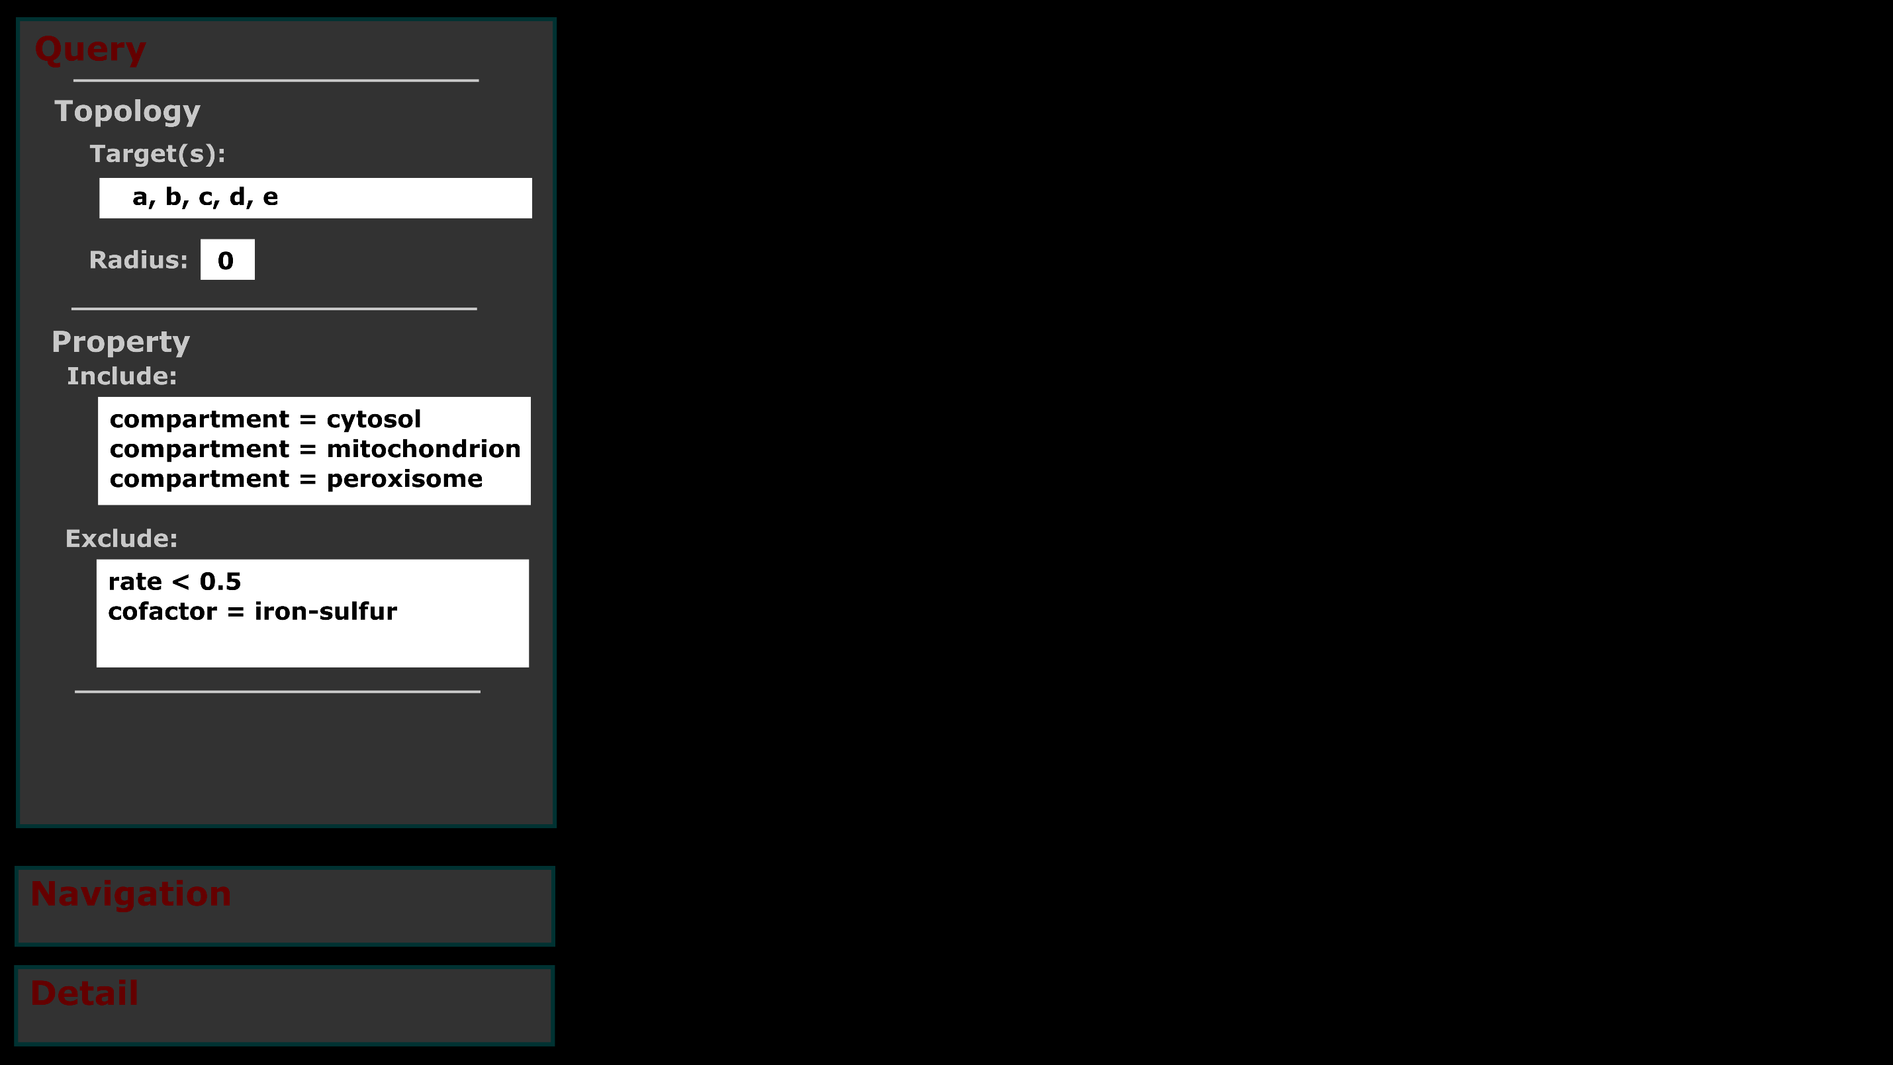
Select nodes and links by topology.
Paths between multiple nodes.
Paths by proximity.
Select nodes and links by property/attribute.
Inclusion criteria.
Exclusion criteria.

Slide 8
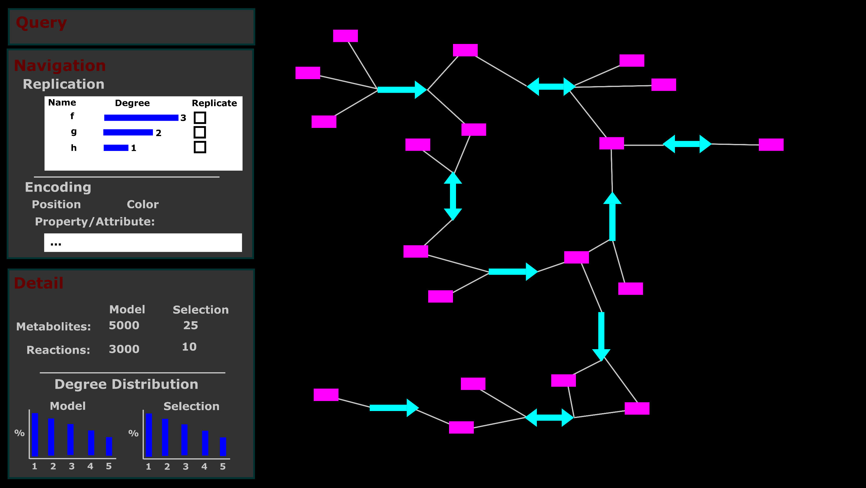
Replicate nodes with high degrees.
Represent properties/attributes on network.
Detail on model and selection.
Network representation.
Notes:
Exploration Tasks
1) Represent selections of the metabolic network visually.
-Nodes and links.
-Flexible, dynamic representation to accommodate custom selections.
2) Display network information (distribution of degree, betweenness centrality, and sets) for entire model and selection.
3) Provide option to replicate nodes with high degrees.
4) Represent properties of nodes and links on the visual network.
-Arrange nodes and links in positional groups for sets (cellular compartment, pathway).
-Color nodes and links for sets (pathway).
5) On selection of nodes or links, display summary information for metabolites (common reaction partners, set
distribution) or reactions (genes, transcripts, proteins).

Slide 9
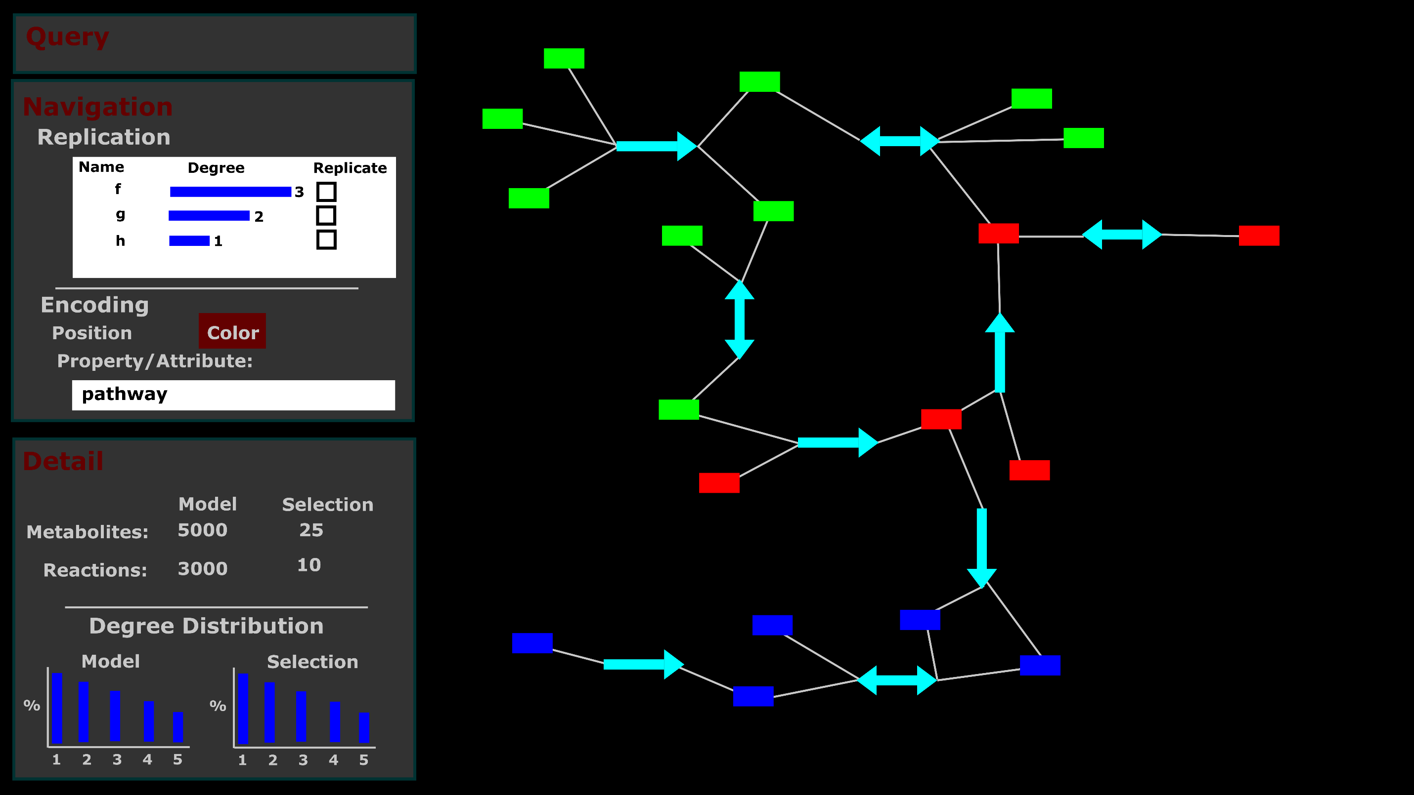
Represent property by color.

Slide 10
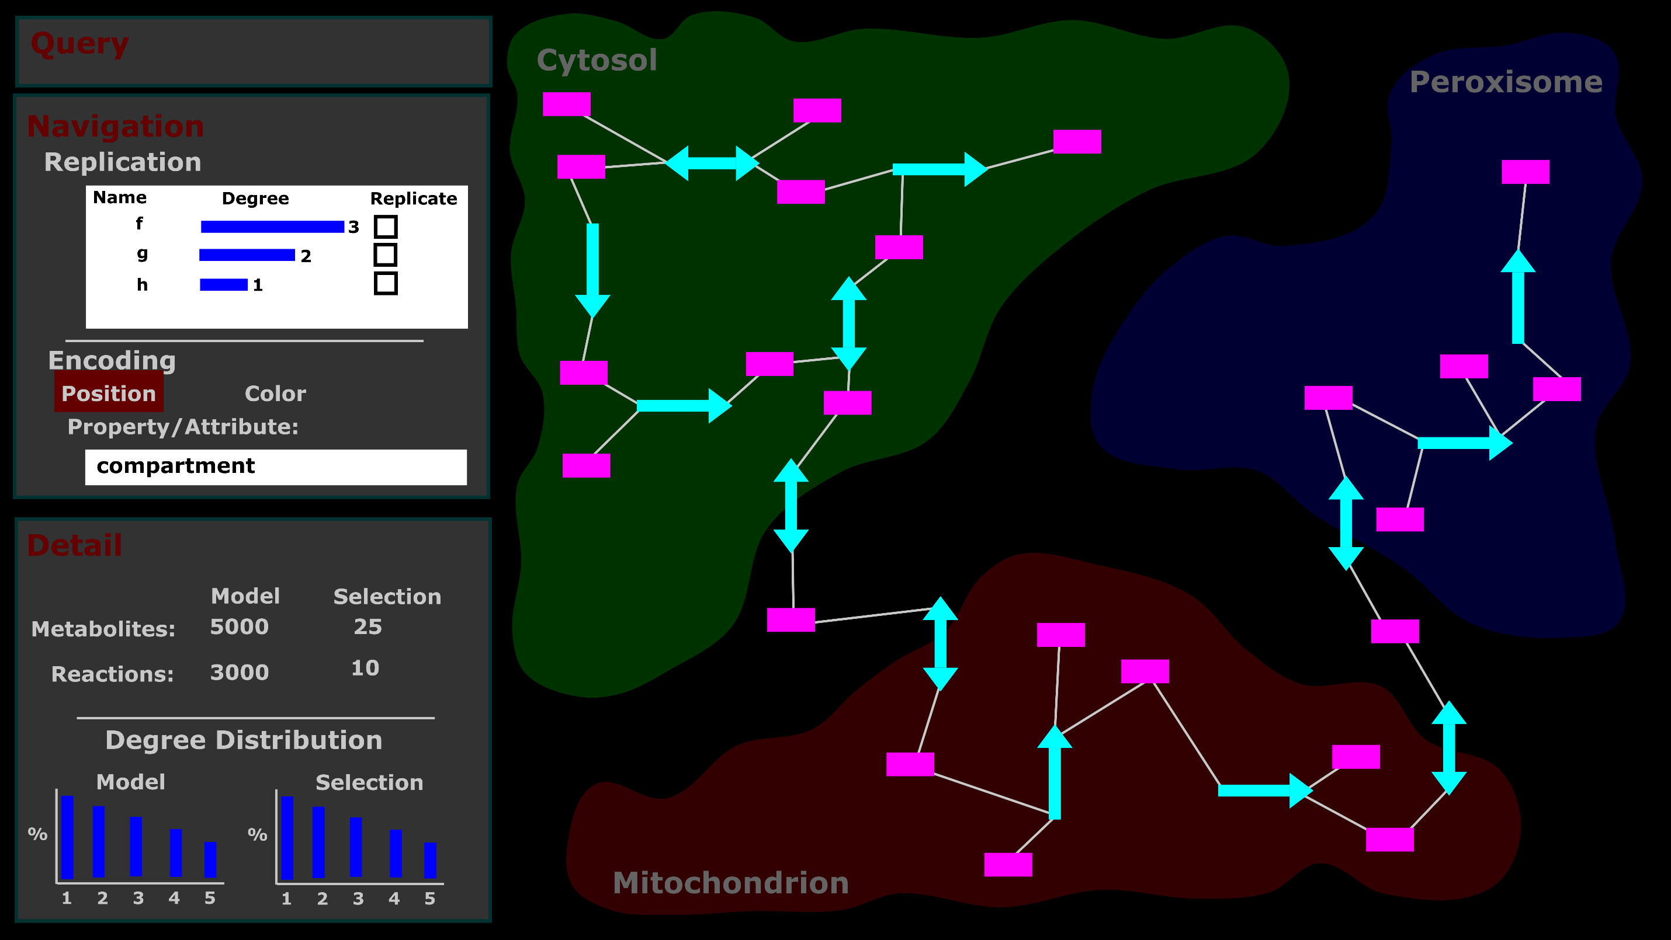
Represent property by position.

Slide 11
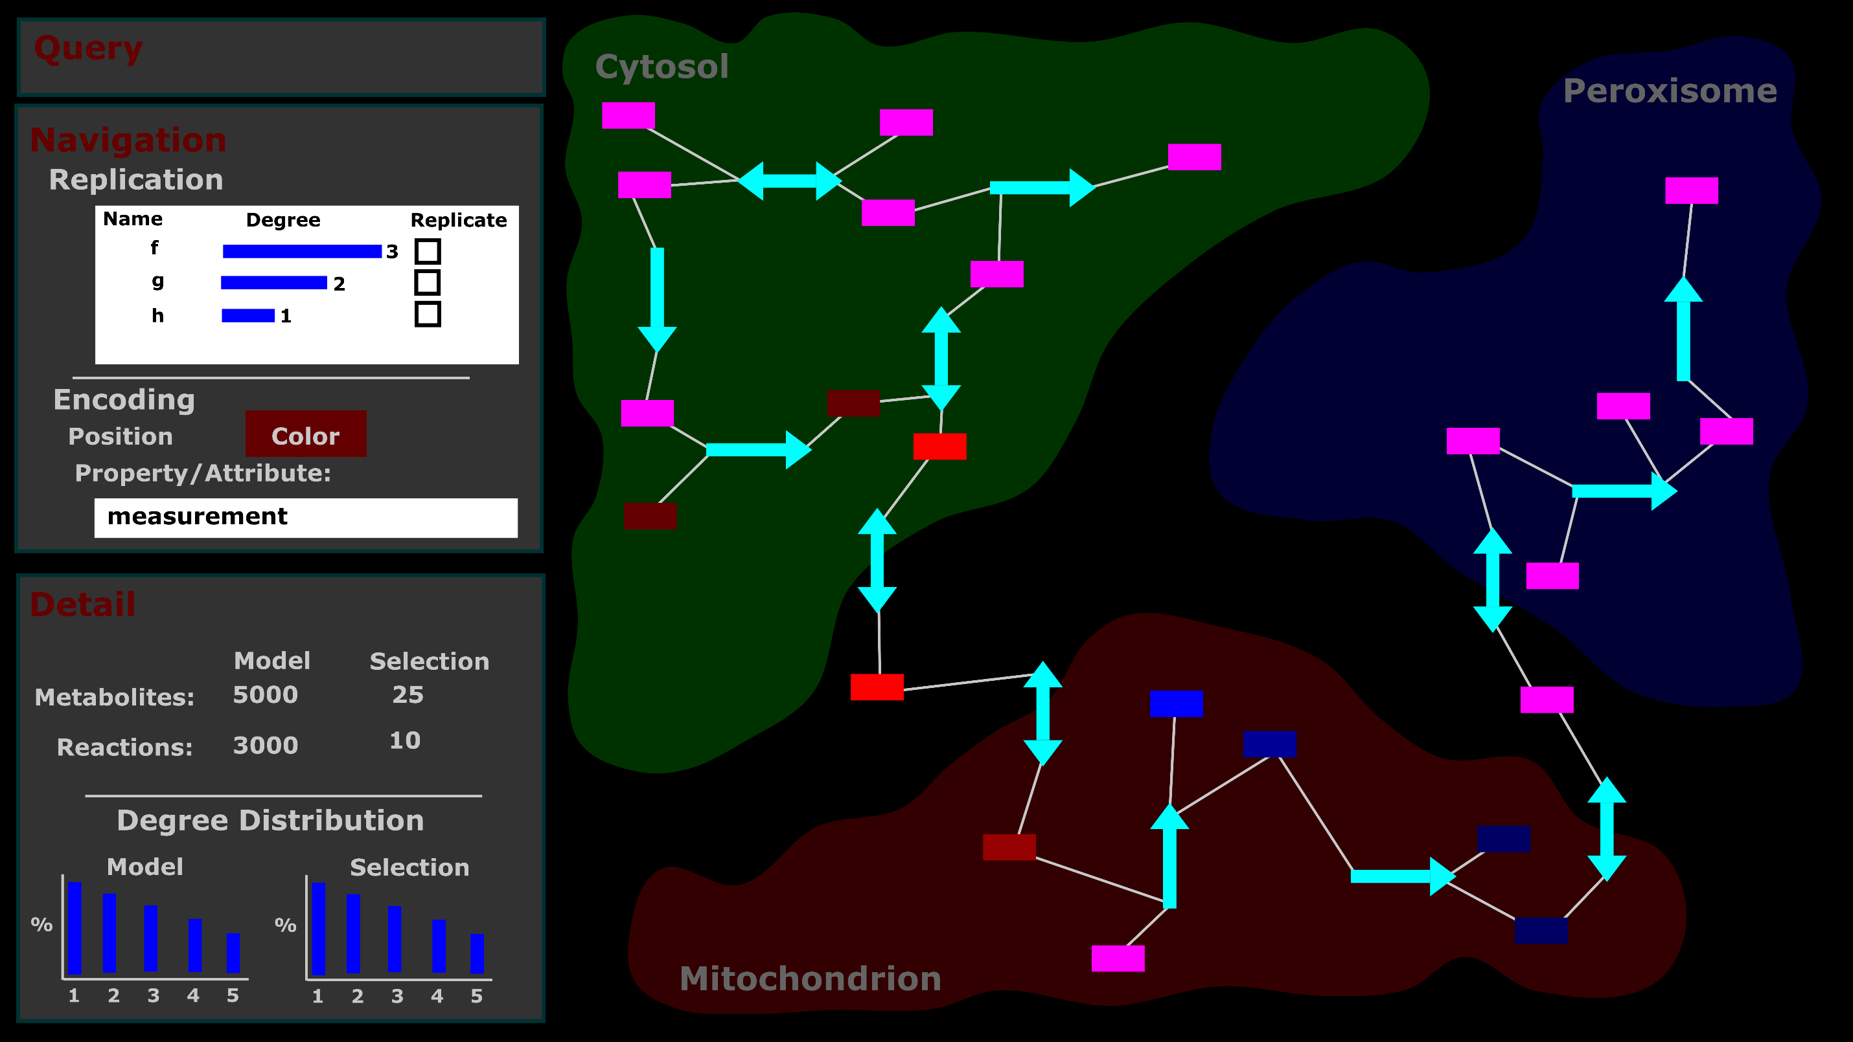
Represent quantitative attribute by color.
Notes:
Measurement Tasks
1) Represent selection of specific quantitative attribute by color saturation on the network.
-Either nodes for metabolites or links for genes, transcripts, or proteins.

Slide 12
Prototype
An early prototype…
Notes:
https://tcameronwaller.github.io/profondeur/

Slide 13
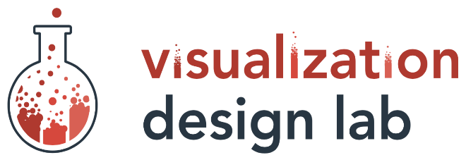



Acknowledgements
Teams:
Rutter Lab
(We need a logo!)
Visual Design Lab
Support:
National Institutes of Health
Training Program
Computational Metabolism
1T32DK11096601
Mentors:
Alexander Lex
Assistant Professor
Jared P Rutter
Professor
Committee:
Brian E Chapman
James E Cox
Adam L Hughes
Janet Iwasa

Slide 15
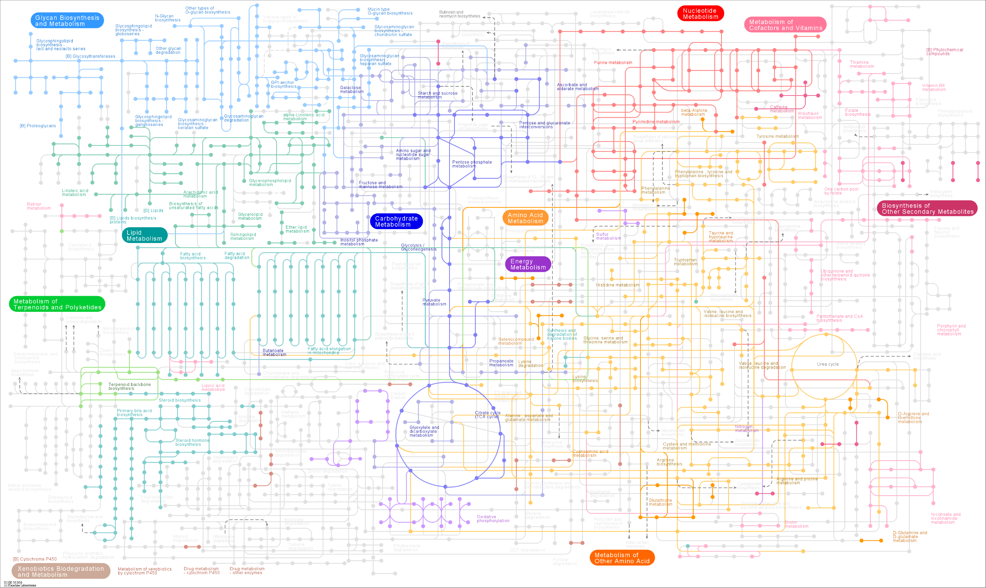
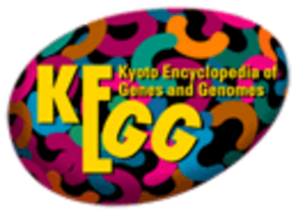
http://www.genome.jp/kegg/atlas.html

Slide 16
Metabolic Network: Entities (Nodes)
Entities:
Genes
Transcripts
Proteins
Metabolites
~ 70,000
> 70,000
~ 30,000
~ 30,000
Properties:
Compartment
Cofactor
Attributes:
Modification
Abundance
Notes:
Entities: Genes, Transcripts, Proteins, Metabolites
Represent entity by node or graph vertex

Slide 17
Metabolic Network: Relations (Links)
Entities:
Genes
Transcripts
Proteins
Metabolites
~ 70,000
> 70,000
~ 30,000
~ 30,000
Relations:
Encoding:
Properties:
Directionality
Rate
Pathway
Anabolism/Catabolism
Reduction/Oxidation
Expression:
Regulation:
Catalysis:
Transport:
Reaction:
Notes:
Relations:
-Encoding: Biological Sequences, Genetic Code (Gene-Transcript-Protein)
-Expression: Regulation of transcription and translation (Protein-Gene, Protein-Transcript)
-Regulation: Allosteric regulation (Metabolite-Protein), Post-translational modification of proteins (Protein-Protein)
-Transport: Metabolite transport (Protein-Metabolite)
-Catalysis: Enzymatic catalysis (Protein-Metabolite)
-Reaction: Chemical reactions (Metabolite-Metabolite)
Represent relation by link or graph edge.
Need to consider (and associate data to) entire network.
Too many types and counts of entities and relations to represent simultaneously.
Essential to represent subset according to interest.

Slide 18
Metabolic Network: Representation
Reactant
Metabolites
Product
Metabolites
Reaction

Slide 19
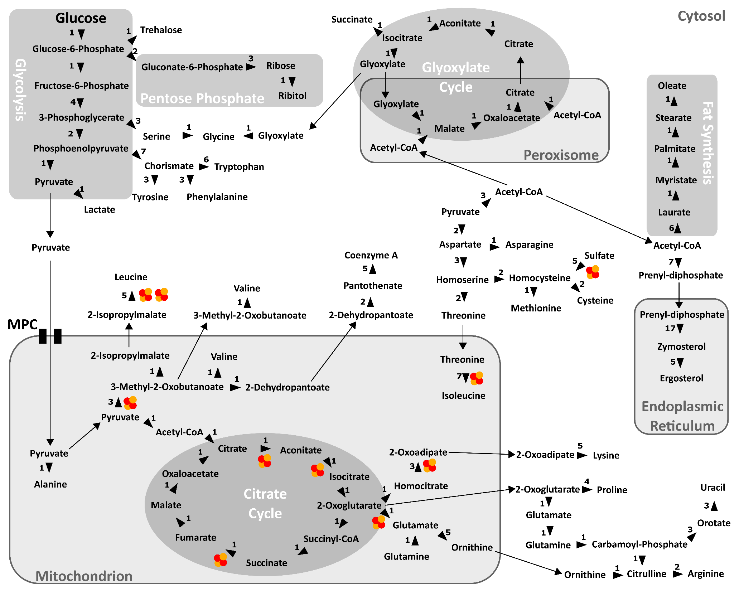
Notes:
Incomplete representation of metabolism
Arbitrary bias
Neglect of potentially-relevant nodes and links
Poor mapping of data
Map-like layout distorts network connectivity/topology

Slide 20
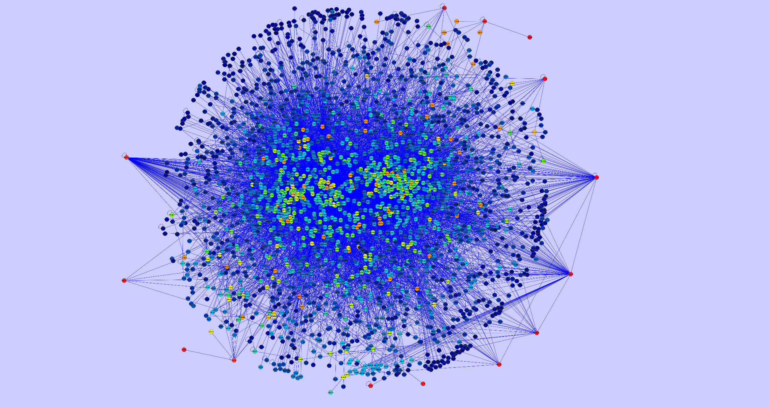
Gabor Ivan, Vince Grolmusz. Bioinformatics. 2010.

Slide 21
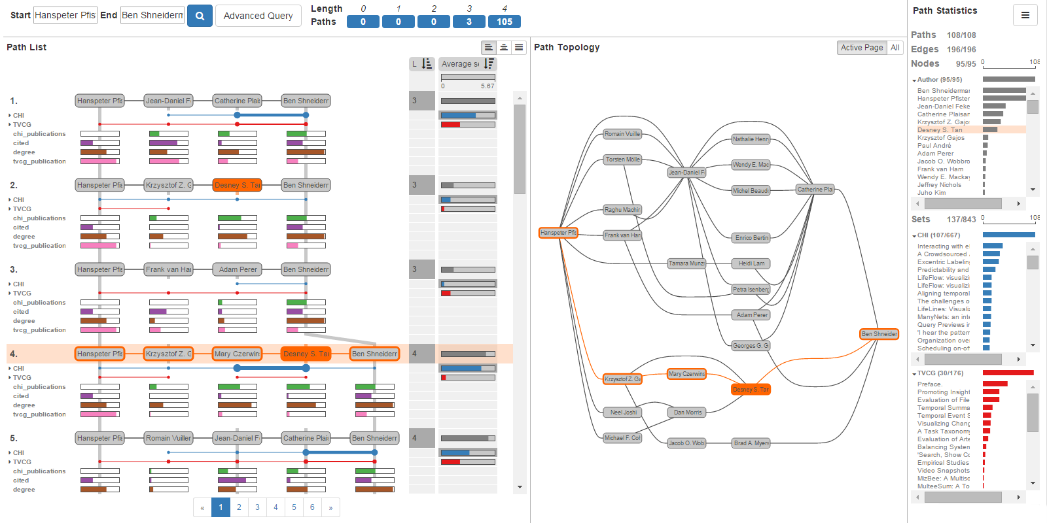
Network Visualization: Query-Based Exploration And Analysis
PathFinder
Christian Partl, … Alexander Lex. EuroVis. 2016.

Slide 22
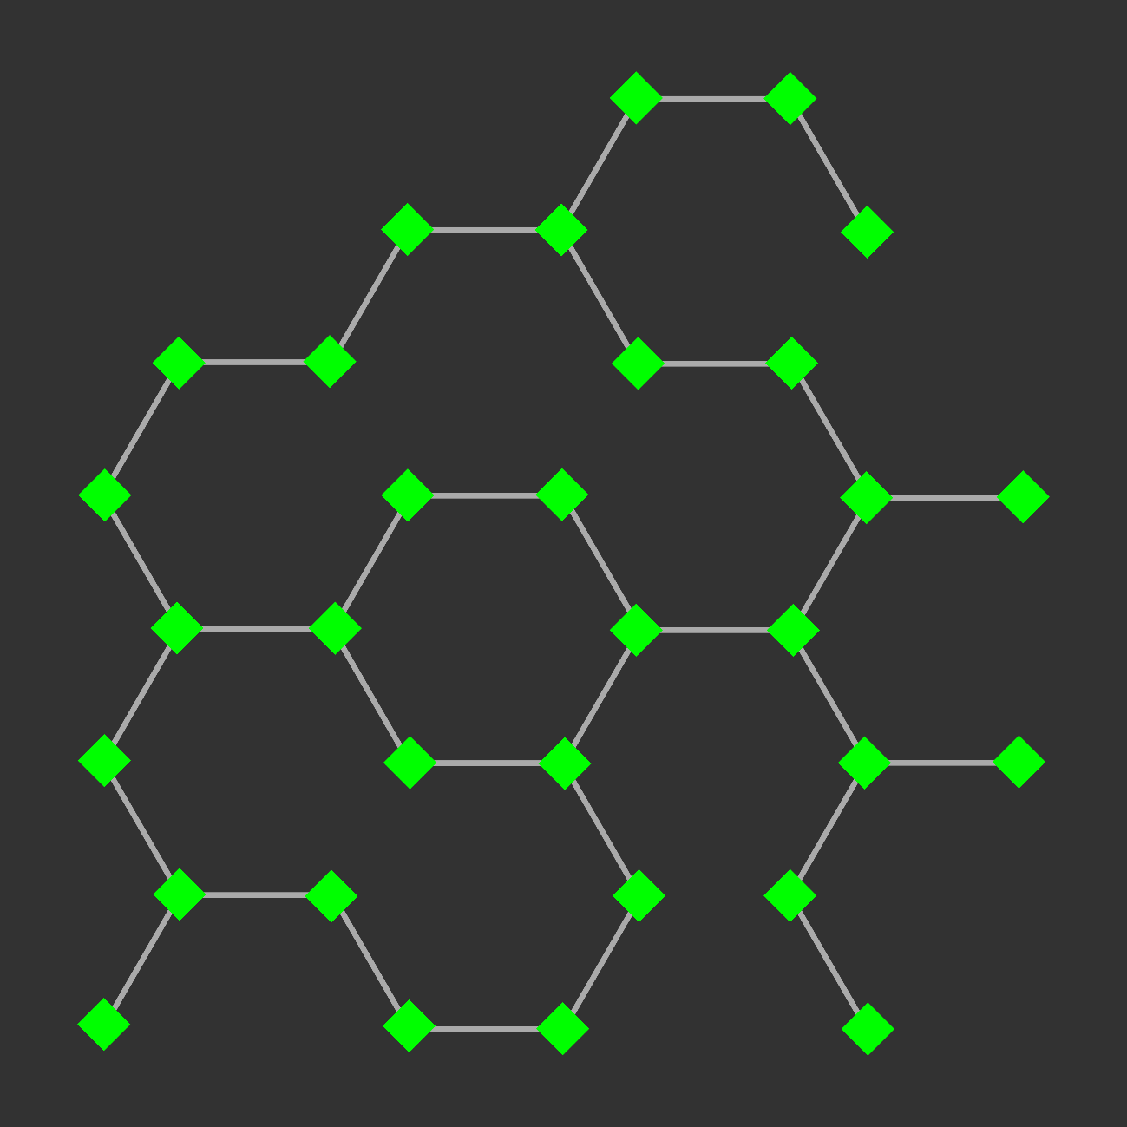
Network Visualization: Exploration And Analysis

Slide 23
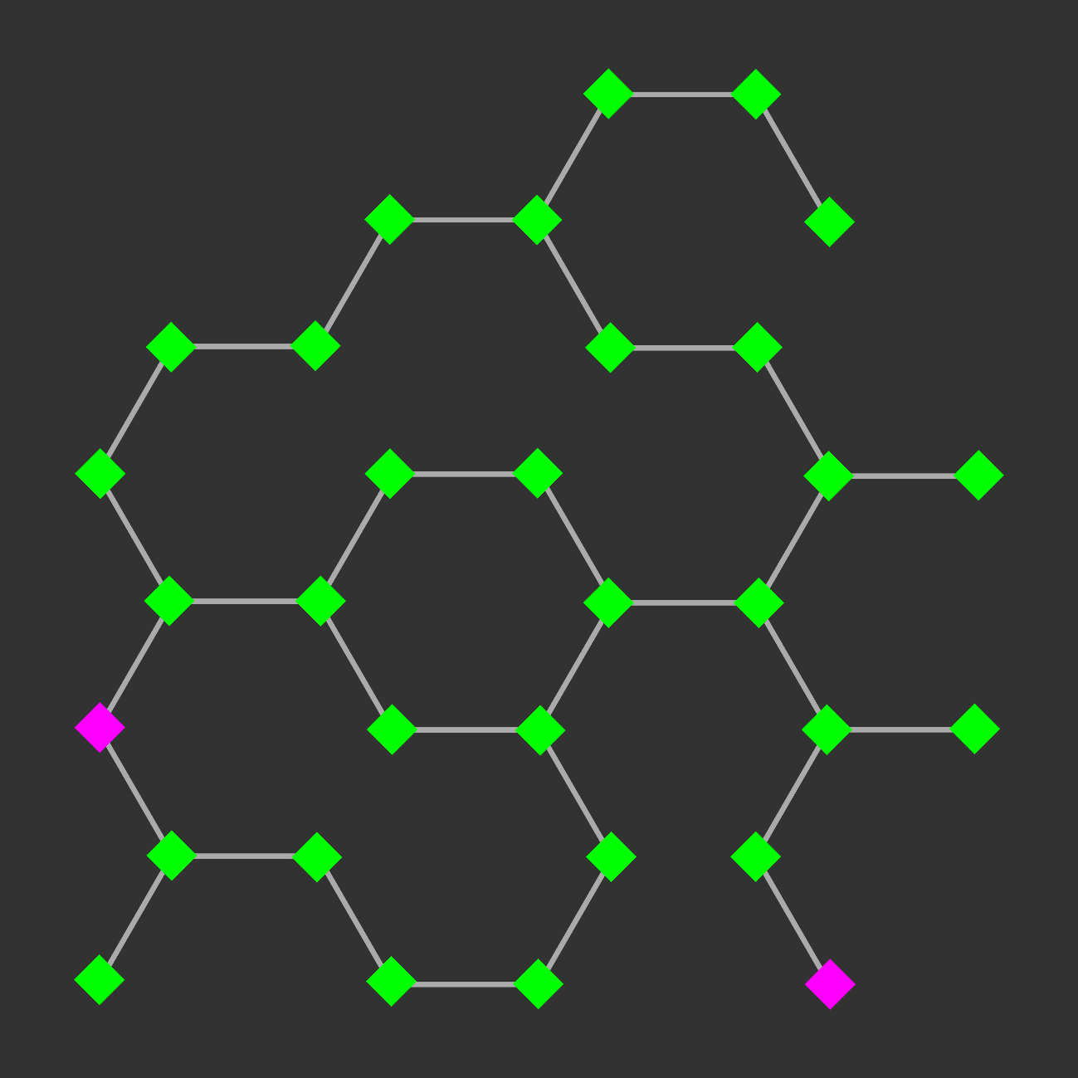
Network Visualization: Exploration And Analysis
Find paths between nodes:
- Shortest path

Slide 24
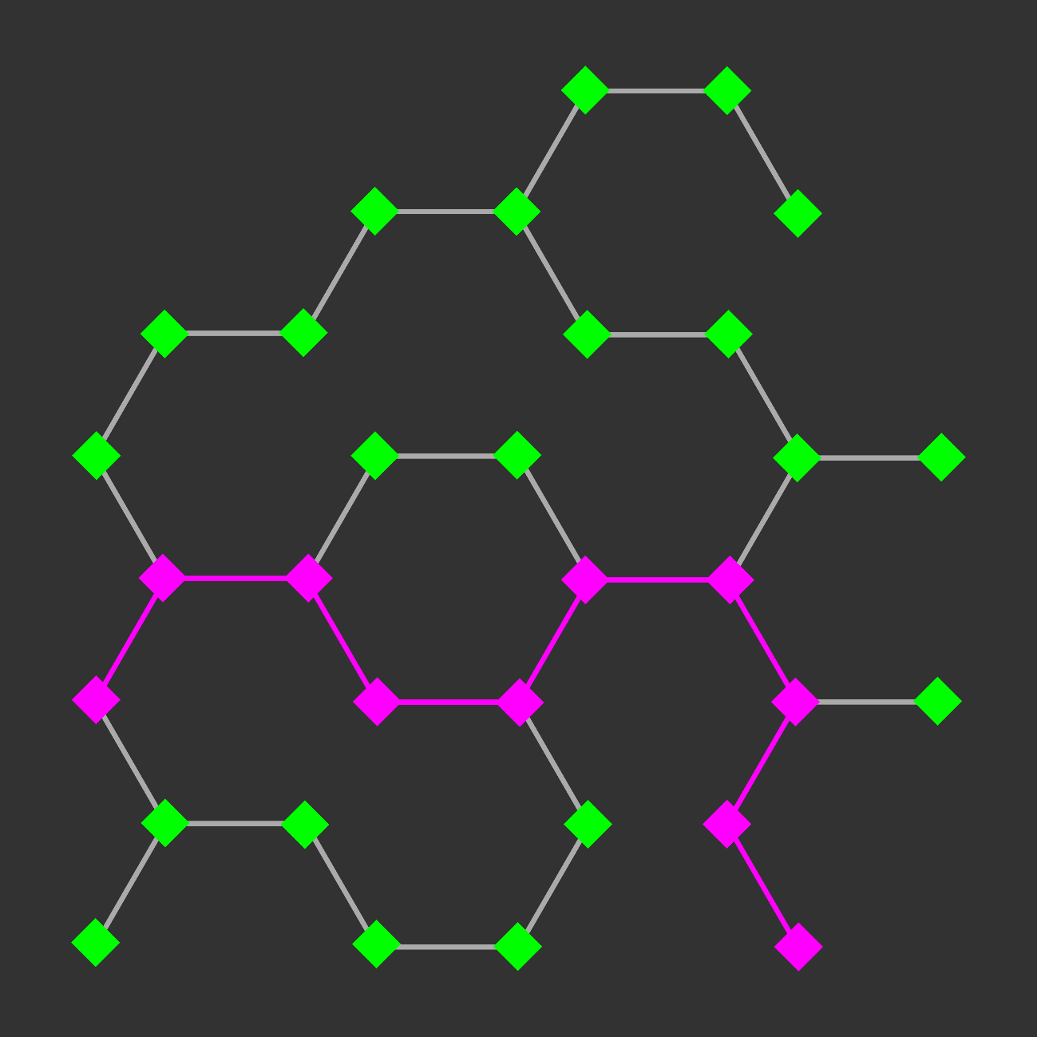
Network Visualization: Exploration And Analysis
Find paths between nodes:
- Shortest path

Slide 25
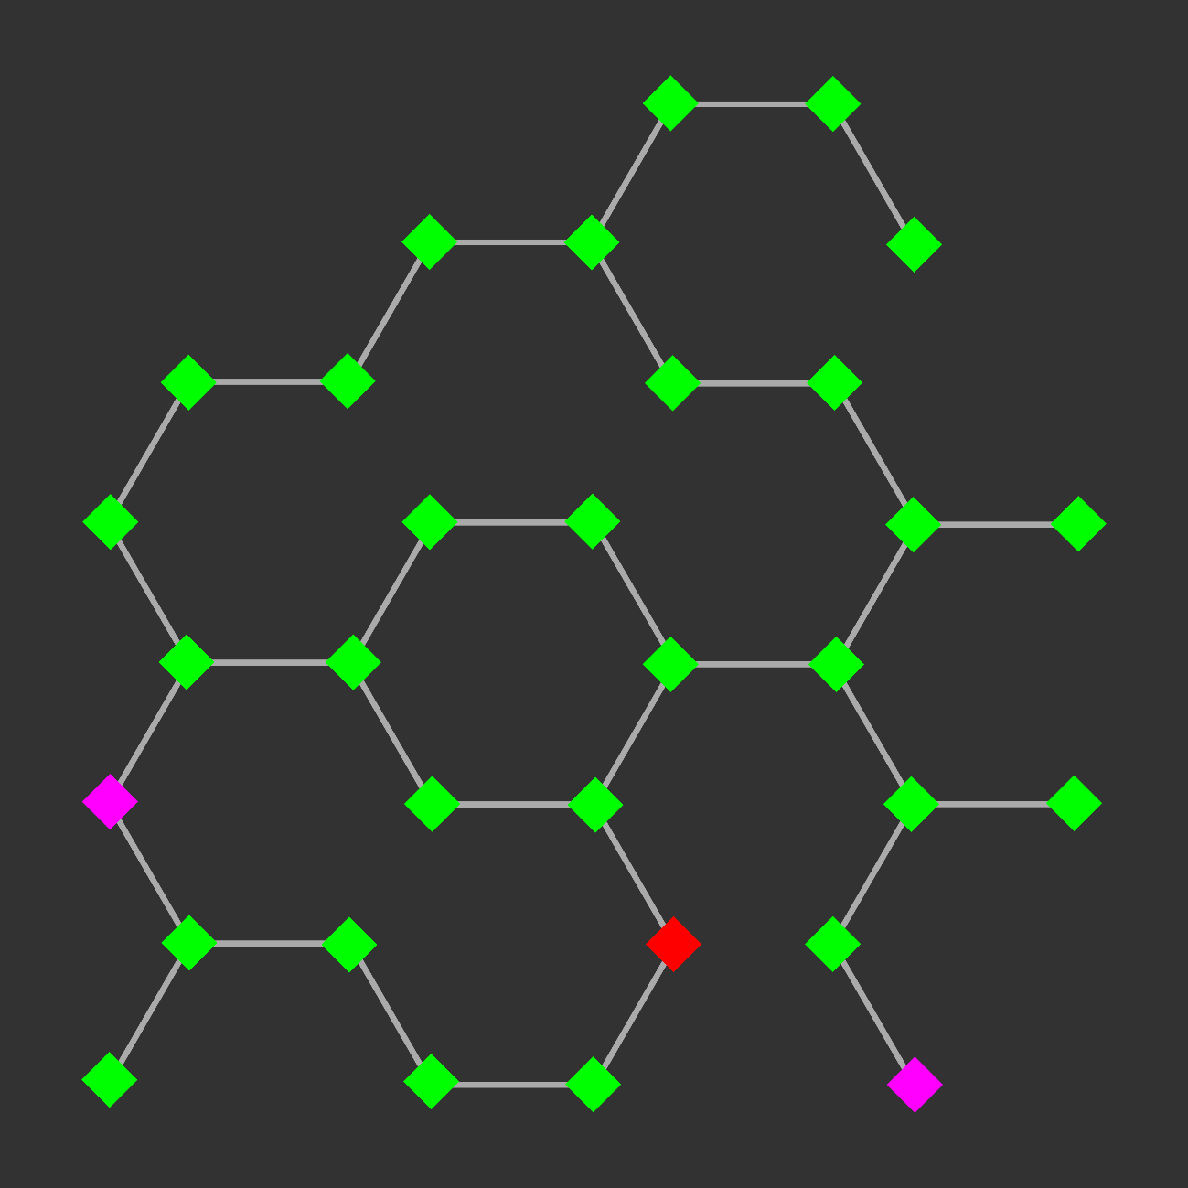
Network Visualization: Exploration And Analysis
Find paths between nodes:
- Shortest path
- Shortest path including or excluding another node or classification
- Path with greatest flux rate

Slide 26
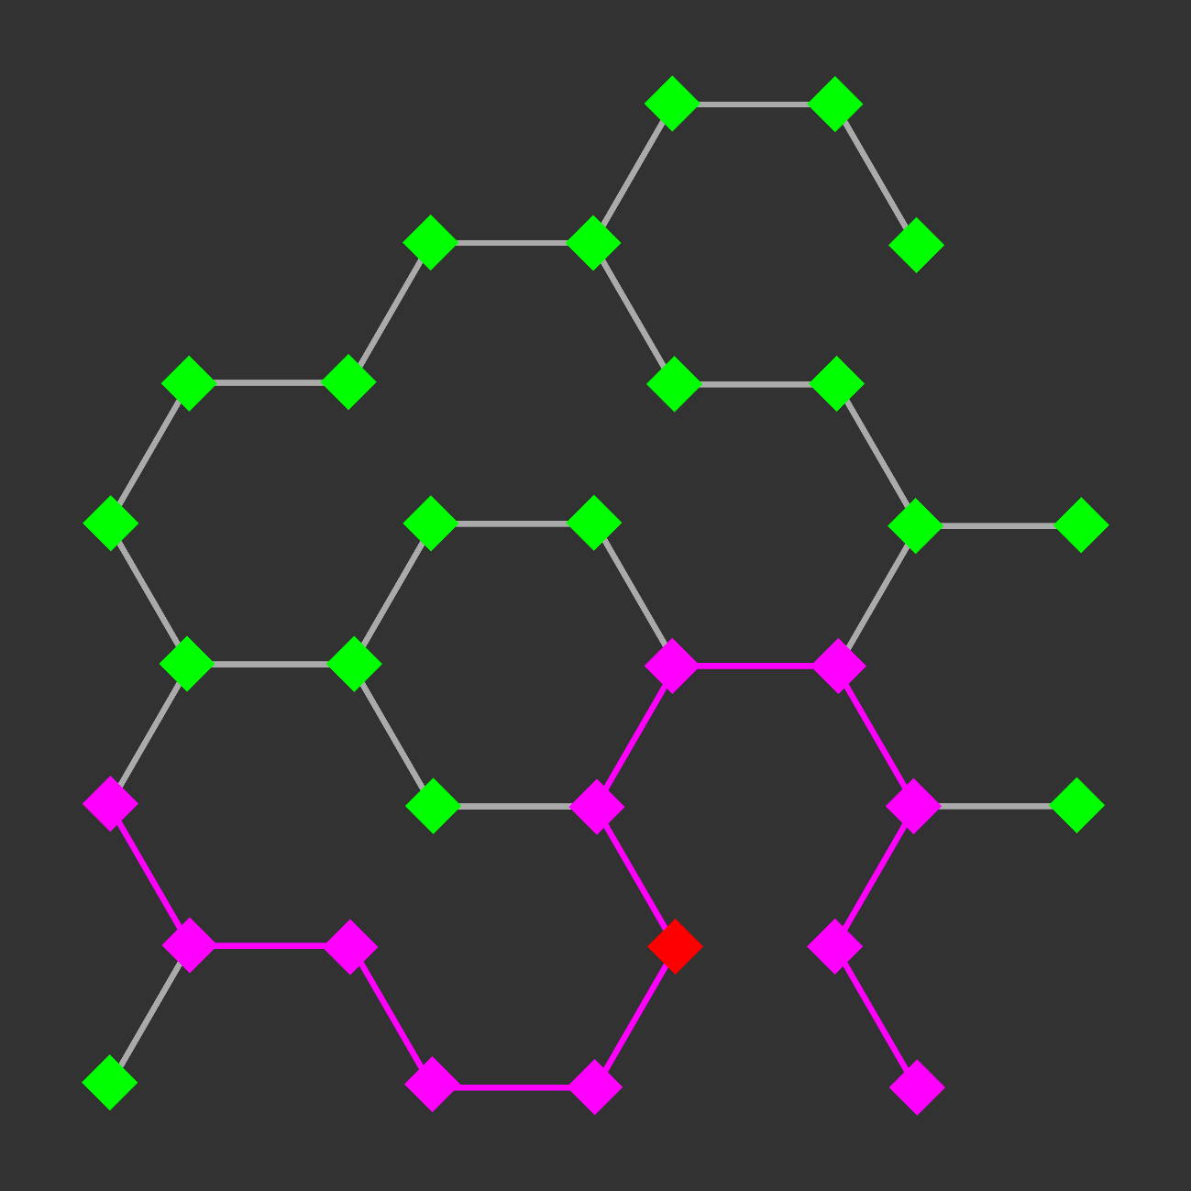
Network Visualization: Exploration And Analysis
Find paths between nodes:
- Shortest path
- Shortest path including or excluding another node or classification
- Path with greatest flux rate

Slide 27
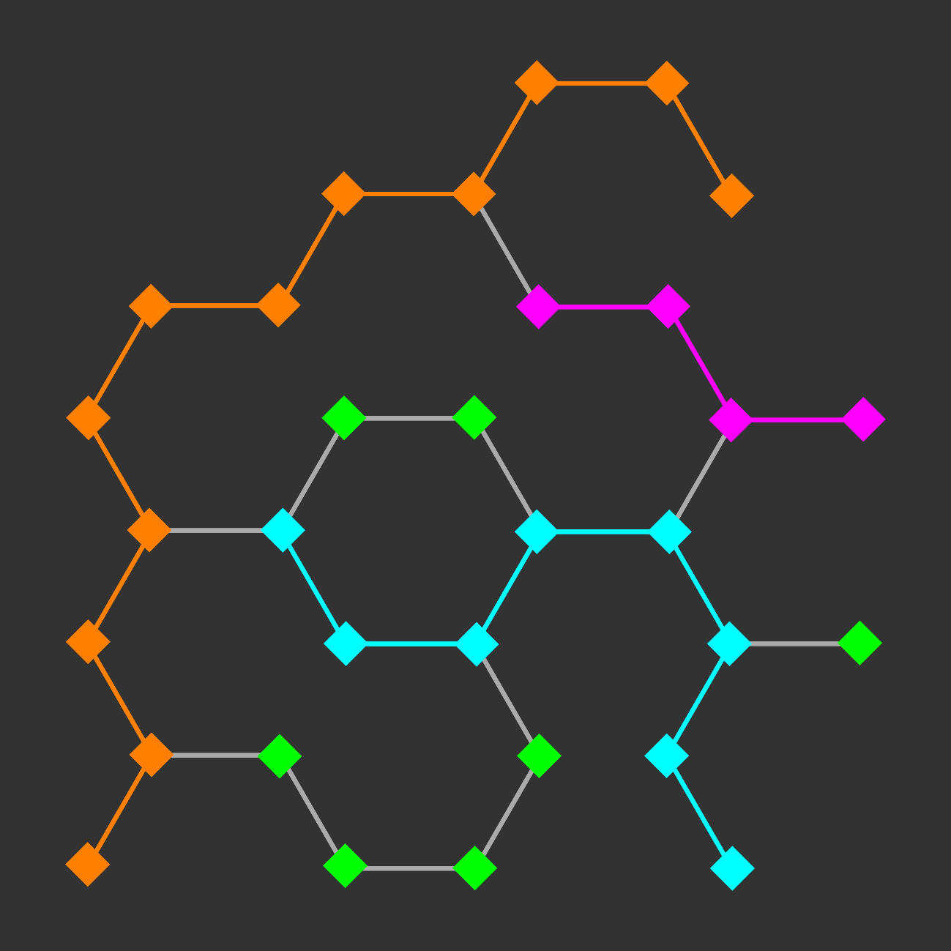
Network Visualization: Exploration And Analysis
Find paths between nodes:
- Shortest path
- Shortest path including or excluding another node or classification
- Path with greatest flux rate
- Specific metabolic pathway

Slide 28
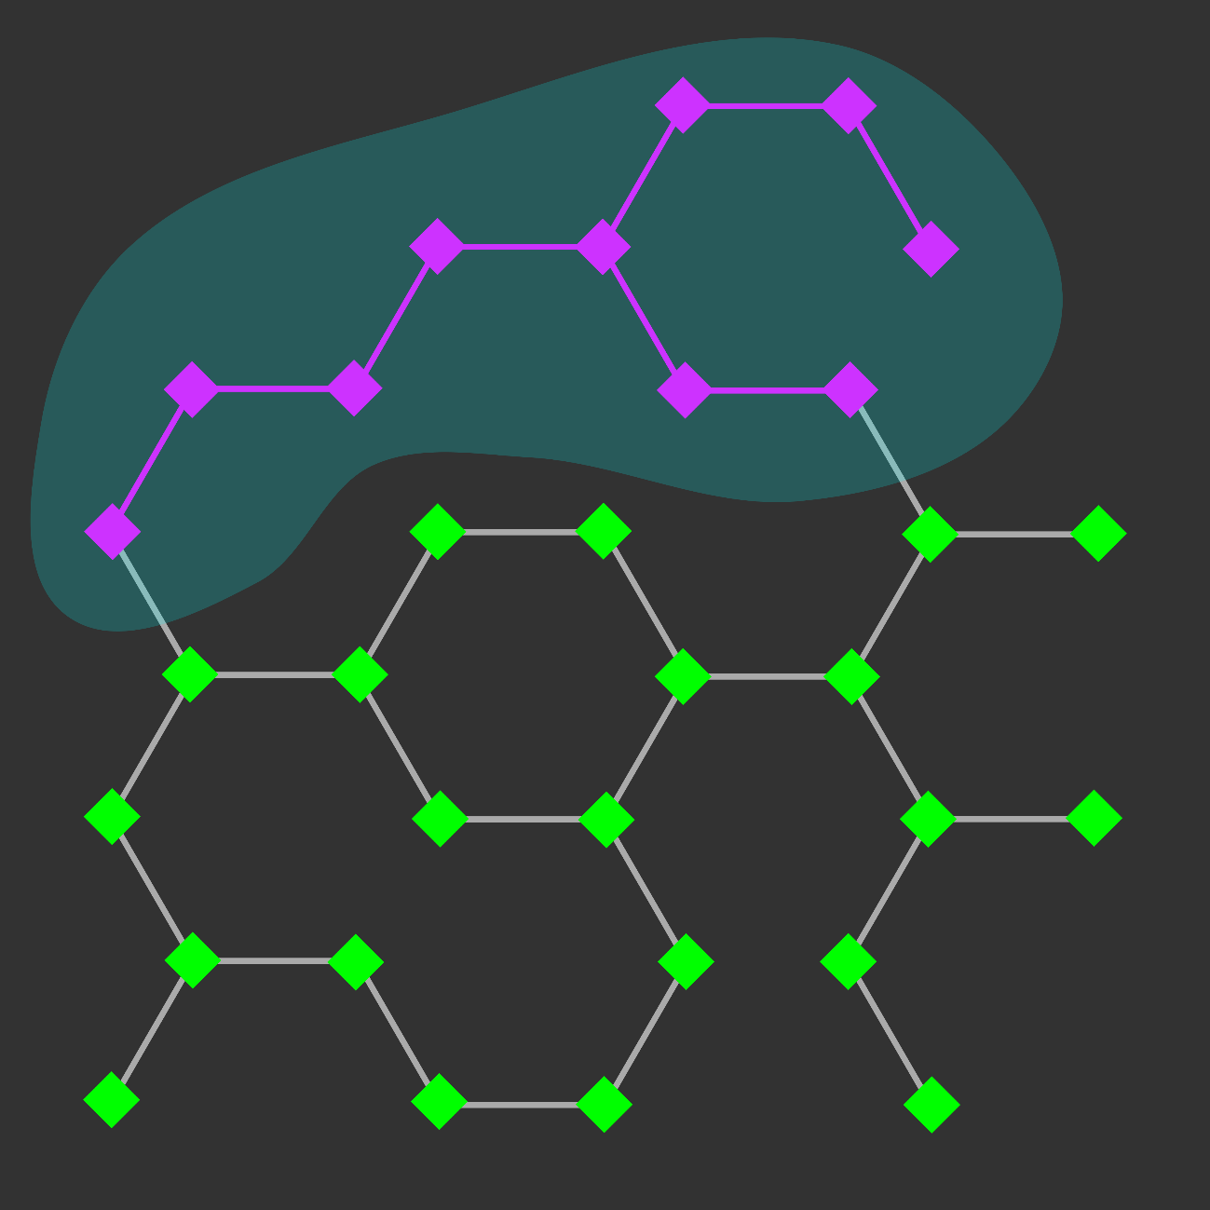
Network Visualization: Exploration And Analysis
Find paths between nodes:
- Shortest path
- Shortest path including or excluding another node or classification
- Path with greatest flux rate
- Specific metabolic pathway
- Specific cellular compartment

Slide 29
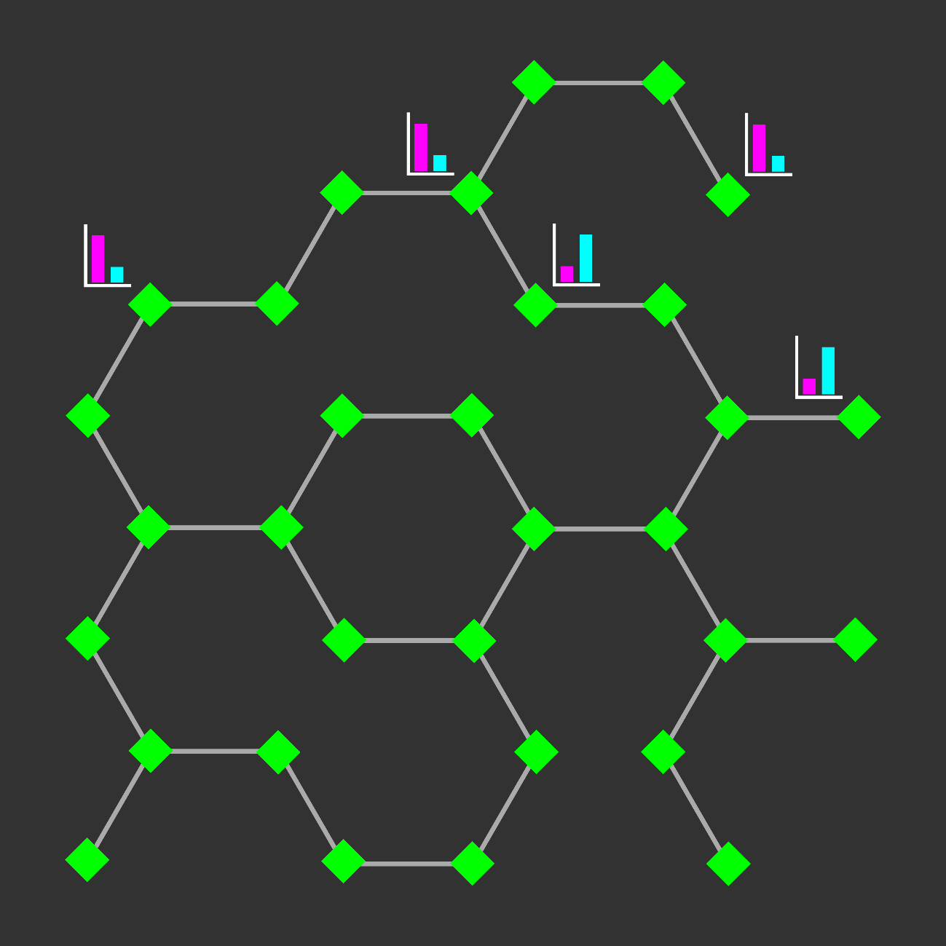
Network Visualization: Exploration And Analysis
Find paths between nodes:
- Shortest path
- Shortest path including or excluding another node or classification
- Path with greatest flux rate
- Specific metabolic pathway
- Specific cellular compartment
- Paths between all nodes with significant change in experimental data

Slide 30
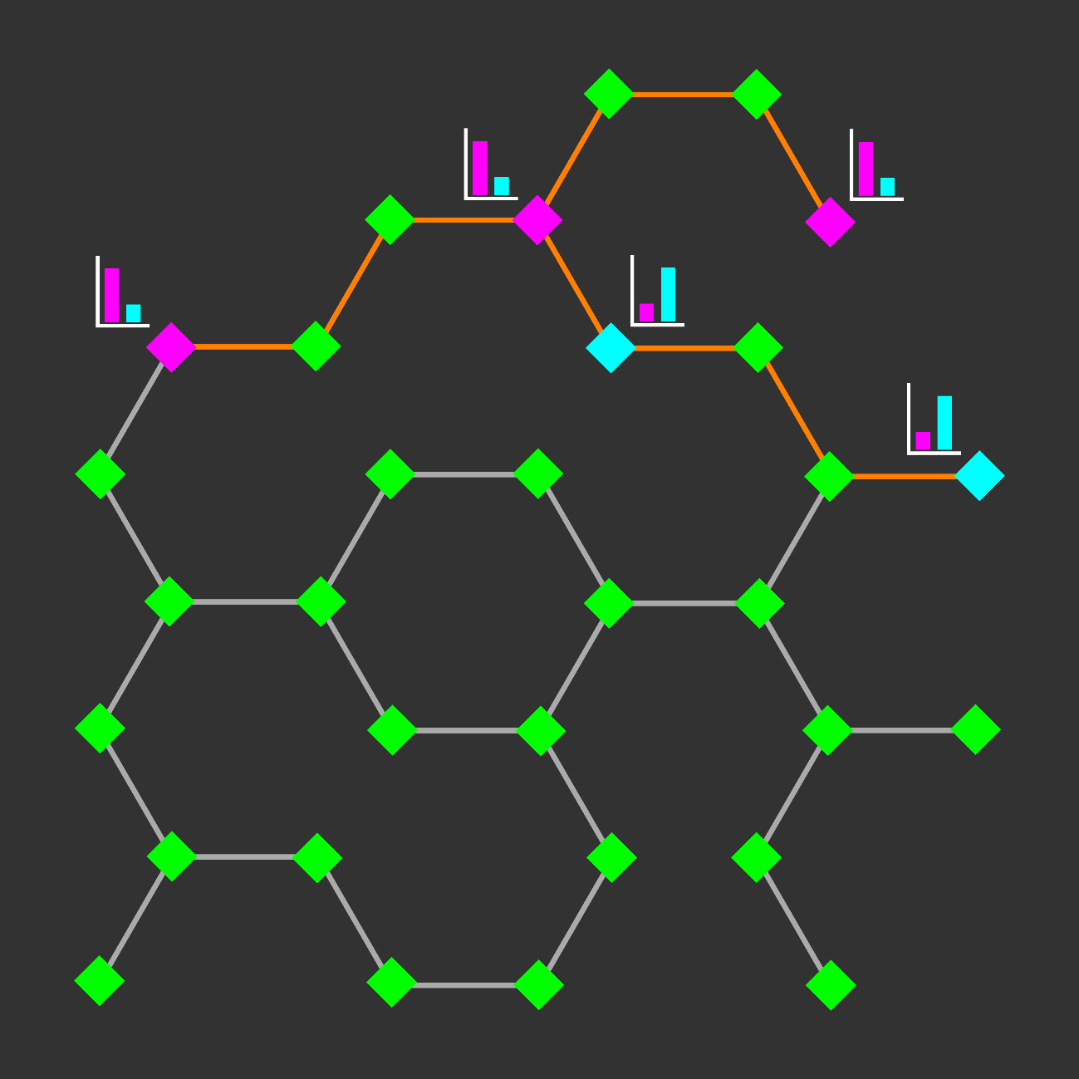
Network Visualization: Exploration And Analysis
Find paths between nodes:
- Shortest path
- Shortest path including or excluding another node or classification
- Path with greatest flux rate
- Specific metabolic pathway
- Specific cellular compartment
- Paths between all nodes with significant change in experimental data

Slide 31

Network Visualization: Exploration And Analysis
Find paths between nodes:
- Shortest path
- Shortest path including or excluding another node or classification
- Path with greatest flux rate
- Specific metabolic pathway
- Specific cellular compartment
- Paths between all nodes with significant change in experimental data
Recognize trends:
- Find common features of multiple nodes with significant change in experimental data

Slide 32

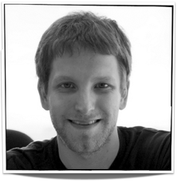



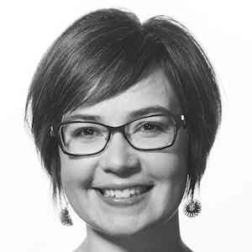
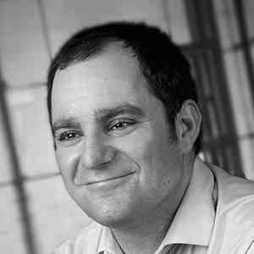
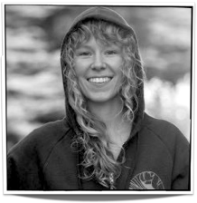


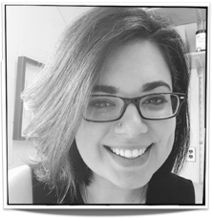

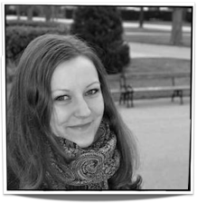
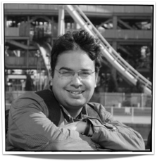
Ethan Kerzner
Alex Bigelow
Sean McKenna
Sam Quinan
Miriah Meyer
Alexander Lex
Nina McCurdy
Jimmy Moore
Asmaa Aljuhani
Carolina Nobre
http://vdl.sci.utah.edu/
Cameron Waller
Magdalena Schwarzl
Sunny Hardasani
Alexander Lex, August 2016

